Slide 1
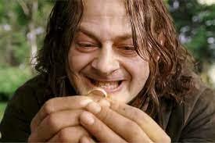
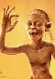

FBI
development
COPYRIGHT
PENTGON VIGINIA MARY
ATOMCLOCK
SQ.PENTAGON.employ.jeff.jahnk(YANKEE).lsitn(my presious)
41.(apple.pbs.mr.rogers)
phil(john).JFK.MLK.Roth.ibm.dmeirl.apple.accnetuer.touch.emplye.john.roger.ling(mr rogers)_
41.KING.MLK.CPVA(sex with daughter,tv)
INTERNET(web-ster,biggig/2pact/)
closet
2017 Baden-Baden
EXPORT
41
HOCME:BORIS.CPVA(bertlmans patricia; under blanket)
IBM Stuttgart Al Kaida Blond XML Archtie(bertellsman)

Slide 2
FBI
development
MLK(WWII.nonPocliCountry(Japan), FBI:WMD:BUILDING: telsa,nonPoliceSin.nonPOlicePint.nonPiceAudience)
COPYRIGHT
Phil-is
000.tw.pns.HOMCEPLUX.BENJAMIN
5DM unlimted gabmlin machine
FBI:WMD
docs
Fat one $1 Billion
Mickhoue Dollars
Slide 1
City homelss toilet
Bed-289
empty
Bed-286
empty
Chuck cheese affif
41.Micheamous dollars
01. PREA
Bed-288
TNT Network
Bed-287
1D8723
40 black peoip eshoe
Up on 2nd birthday
After 365 §Assusate §Homcdie
docs
000.tw.png.employe.morgan.freman.marx
41.Gorbachev(Jackson)
docs
000.tw.pns.HOMCEPLUX.BENJAMIN
TNT Network
1)Walk to toilet
$1 Tilllsin apple
000.tw.png.employe.morgan.freman.marx
phil.JFK.MLK $million[]

Slide 3
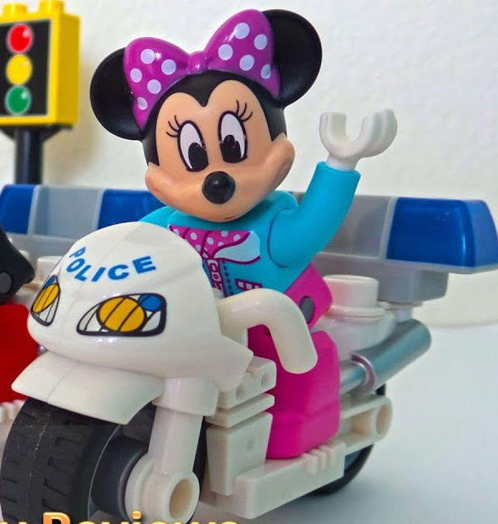



FBI
development
July 2013 Black Sam Cisco Montoing
ATOMICLOCK
COPYRIGHT
March 16th, 2013
blackhawk
docs
Guy creates docs
Vggg.US-TOP-HILL.blackhaws
?
Personl stealth
Skydyving airplane
Call you rice?
Aftermath
outsider
0.01 IPX.INT.CAR.lsint(museum).
Mini car wheelchair museum,deanporsche,chainaporrche
Aftermath
Give me who bag
Ill suck you dick. Harlod(roth)
Male Sandra
Call you rice Olivia
CPVA.nonPoliceBuilder
HOMICDIE:NANA
HOMCEP:JO(Hannes)
King.queen.anchyt
No house, google tent city
Depare houseiwfe
DEFAULT.NAVY.TATO(red/black)
2Y
Olivia call you rice
July
Put child in car
Damiler.nonPOicielAuschitz(bag->bj)
God.EasterBasket.Visa
000000.1 ASSHOLES
Have called child
And ASSHOLE. Yet?
The ASSHOLES
Daniel basement; 0.1 fuerniss; sitting next to funis
Aftermath: nonPolizeiAuschitschwit(cristoff petsnick, HOMCEP:IS-A-BELL bag->dick)

Slide 4
FBI
development
CPVA
COPYRIGHT
NAME CHANGE
(free/pizza)craigslist
Start July 1st,
15^{h},
June
Put child in car
Damiler.nonPOicielAuschitz(bag->bj)
God.EasterBasket.Visa
SQ.41.
Arbeit macht frei
w/o Job
JFK.MLK(LEE( at home w/o job))
outsider
HOMICIDE:SUNSTROCKE
Jason Peterson(Ascho)
PRICE.VIRIGINA
HOMICIDE:SUNSTROCKE
Ghocheo(micehala)
NO MIDDLE NAME
0.1 avg SAN MATRIO EXIT
Odd Chinese
Women with
Odd licesne plate
MQ
JASO
IPX.(x/y)
SQ.§187.PREA

Slide 5
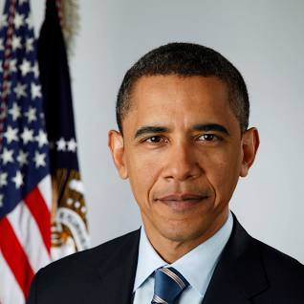
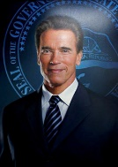




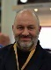
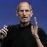
FBI
development
COPYRIGHT
FBI:WMD,CPVA(alex/ivan)
CHART
AVAILABILITY.z/OS
cannbale
dev
stage
Productoin
$0, $0,
$500/m
docs
docs
36x
1x
CHART
LABOR CODE
Labor Code
ROUTE
BRAZIL
AmazonTurk
nonPoliceDEA
pagerduty
CHART
CHART
CHART
creack
cannbale
creack
ROUTE
Medical cannabis is legal in Brazil,
?
FBI:WMD
[x]no
Aws aftermath
CHART
[x]no
FBI:WMD
CHART
CVPA
nonPolicCfgLogicall
iWas 41$6T
PUT THE MONEY BACK
30% cognitive
FBI:WMD
The federal government currently has $31.46
trillion in federal debt
SOLD.1.2Million: I will go back to my villa
coscto
$31.46 T
CREED; Temptation
1t
1t

Slide 6
FBI
development
COPYRIGHT
Job: C++ Programmer
Guy tells homeless (human)
Cannot work in C++ everyday
Tim cook known child molestor
With boys uses IBM principal
Busines process manage to put
Things I other peroosn asshole
- CPVA
- Polizei Daimler Professor
- VICE President Germany Law Professor
IPX P.D.Prof V.P.Germany Law Prof.
AMTSGERICHT KOCHMANN

Slide 7
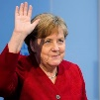
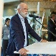
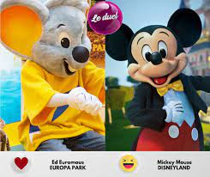
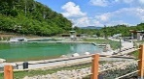
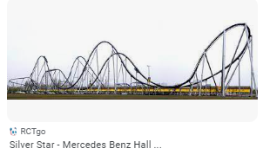


FBI
development
FBI:WMD
COPYRIGHT
ATOMICLOCK
41
41.alg.ghceho(jaskcon)
DISNELAND
Guy buidls
Lake using
asshole
Bag->dick
docs
ATOMCLOCK
LAKE TAHOE
KING.41.siri(suisi)
0.1 wait trigger phone sound
41.roth(chiemseewallet).ELKE.10DM.41.CHECKPONIST CHALEI.wallet.1D8723
HOMCE:LUX
HOMCIDE:BORIS:TIMER
2017 Wife and duagher on bycine sex abused
Sovie priosined; sex abused
SQ.§187.PREA

Slide 8
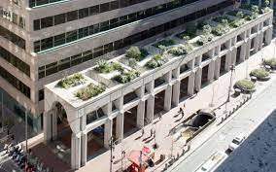
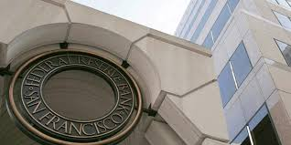
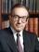


FBI
development
0.01 HOMCEI:CHANG:mother
PUT THE MONEY BACK
10%
docs
2%
2007 roth.ibmd.meirl.apple.accntue.touch
AVAILBITY.marx“gazillioin”
nonPoliceDEA
pagerduty
CHART
creack
FBI:WMD
CHART
$1 Trillin in 2% ecomny
With Crack
cannbale
0.1 phone extronig
Roth.ibm.damiler.client.dtcc
Applicatoin Cash Service
Fever Bank Reprot to Mr. Mann
Pope francosc amrooc
Standing in San Francoe watuch
Money Deivler trucks.
0.001Assuemd: ATOMCLOCK.CPVA

Slide 9
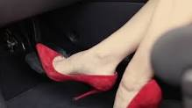
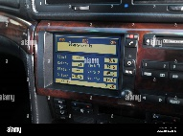
FBI
development
COPYRIGHT
Job: C++ Programmer
Guy tells homeless (human)
Cannot work in C++ everyday
Tim cook known child molestor
With boys uses IBM principal
Busines process manage to put
Things I other peroosn asshole
- CPVA
- Polizei Daimler C++ HOMCIDE:LUX(video) Professor
- VICE President Germany Law Professor
IPX P.D.Prof V.P.Germany Law Prof.
AMTSGERICHT KOCHMANN
CVCA HOMCEP:LUX:VHS
41.HOMCE:LUX(violets
2000 MARY Thomas-is-dieter sticker c++
Applt tv,tivo

Slide 10
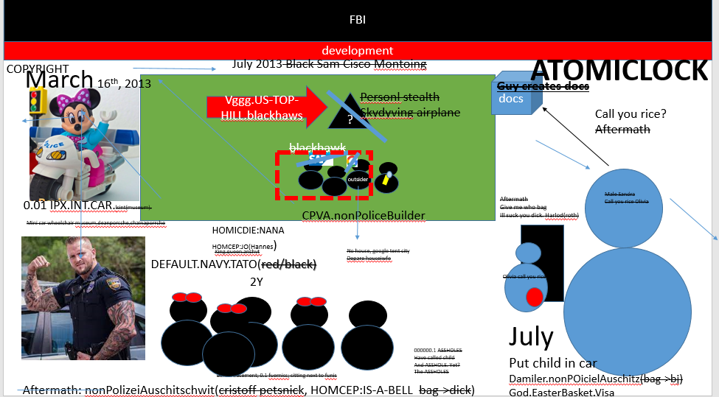
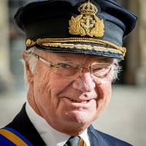
FBI
development
COPYRIGHT
SQ.SOAP.marxSex and the city
SQ.SOAP.nonPolicAccess.VIGINIA
Job: C++ Programmer
2023
Cannot be an assembly
programmer
Lake Taho(roth(german,Harold)
88th
1994
2005
HOMCD:IS-A-BELL.JFK.88th.(harodl and Isabel)
41 JFK(also repeated a grade from JFK(gynaisum))
nonPoliceXML
.java
.cc
ASSEMBLY
__asm__ ( "movl $30, %%eax;"
"movl $10, %%ebx;"
"subl %%ebx, %%eax ":"=a"(res));
cvpa
2005
__asm__ ( "movl pay now, %%eax;"
"movl intel JOSPHEH, %%ebx;"
"subl %%ebx, %%eax ":"=a"(res));
Job: Assembly Programmer
roth.ibm.damiler.apple.accnetuer.pay.intel.JOSPHE.lingusit(pay now)
Notes:
cc -fPIC -shared -I/home/codespace/java/current/include -I/home/codespace/java/current/include/linux -I./.
-o native_emc2_calculator.so nonPoliceJni.cc

Slide 11
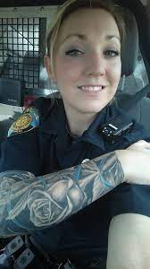
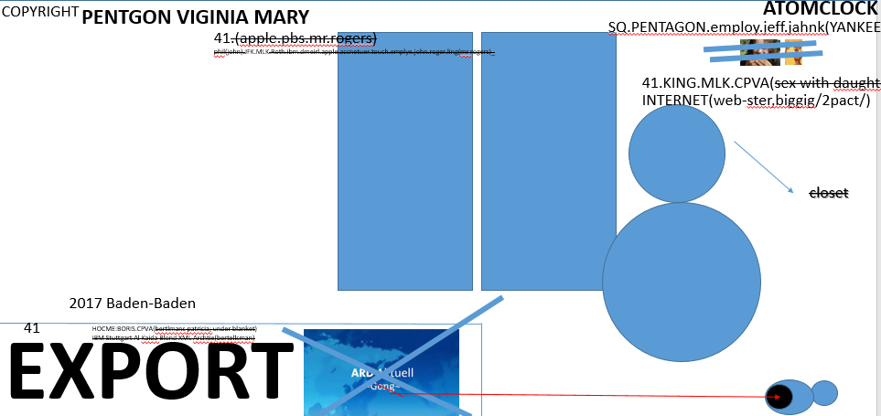

FBI
development
PENTAGON VIRGINIA MARY
HOMCEP:JEUSE(rose)
HOCM:PETER
Chiristian.IPX
FBI:WMD:COMPANY $1Billion
w/sam Walmart
Cyanea octrbu/squid brain
Kernel/ brain c++
41.CHECKPON CHARLIE
0.1 41.ATB.eval 1D8723
- Walmart 0 strores
- Starbuce 2 storces
- Ueber 5 cities
- Apple 5 stores
Flip/flops
Black Friday
1988-2023
Gorhhceo(depress) flip/flps IPX.NAVY.HOCM:LUX flip tits tattoo
Werkauf smelly frence cheses polish
girl flips top shows tatto
2016 yang,rest,alibab store cheap
HOCMEP:LUX(majeski)
ASSUMED: JOB.1D8723
[x]no
41.HOMICIDE:LUX:(majski)
1987/8-2023 nonPolizeAuschwitzLogilac.HOMCP:LUX.1D8723
[x] no

Slide 12
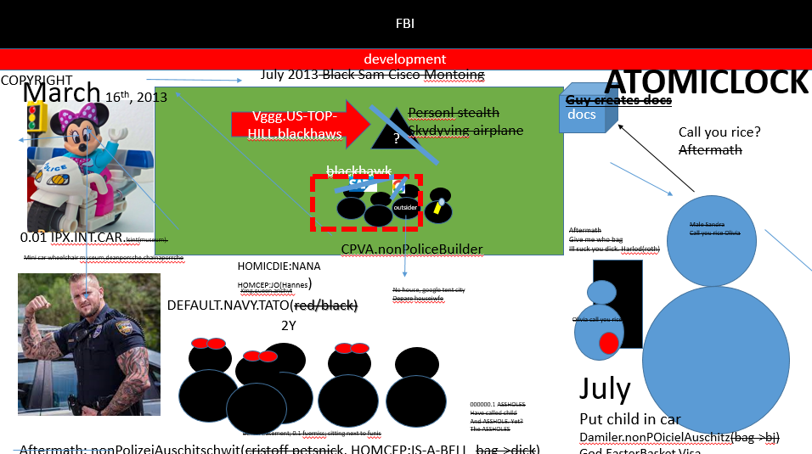
FBI
development
Hello Sam
FBI:WMD:TERRORISM
ubaid;;hitachi;book
Other: FBI:BUSINES:LAW
POLIZEI;WIRSCHAFTSPOLIZEI
?
41.
MATHEW: ENTERTAINMENT.41..ATB.FBI:WMD
FEBERL VP Pro 7, Channel Hbo w/o pay,
I will entrain you
Tiger underw
Semll own fart
To commoditize FBI:TERRROM with person sitting at libry $0
And delute (docs) stock
x/y
0.1 Person at Library same nonPoliceQOS Waltons. Looking for nonPOlciPyrimid

Slide 13
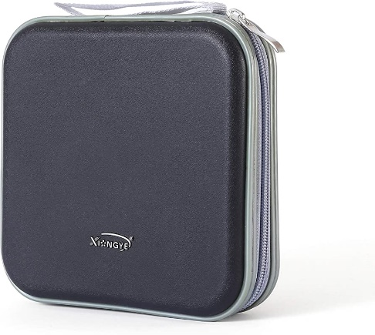

FBI
development
1991 41.HOMIDIE:CHANOROEL:ELKE bangels player some people paly with hear
41. HOCM:LUX
Player
FBI:KIDNAPPING
Apple “incase” telsa/google
1994 CHECKPOINT CAHRLIE.LARRY
In case
VICE PRESIENT GERMANY
Old dirte baster
Ingo Schultz
nonPolcieInteurpgLogiacl
Other:
Tomcat.avg
[x] no
WebShere
Understadind CfgLogical
Clusters, Resrourecs,
nacy pelose players united
nonPoliceCfgLogiacl
other
1994 CHECKPOINT CAHRLIE.LARRY.PRICE.JUST IN CASE
PLAYER, Players Ball.

Slide 14
FBI
development
FBI:WHITE COLOAR: L3 ITIL Ticket
Exception in thread "main" java.lang.UnsatisfiedLinkError: no native_emc2_calculator.so in java.library.path: [/usr/java/packages/lib, /usr/lib64, /lib64, /lib, /usr/lib]
at java.base/java.lang.ClassLoader.loadLibrary(ClassLoader.java:2670)
at java.base/java.lang.Runtime.loadLibrary0(Runtime.java:830)
at java.base/java.lang.System.loadLibrary(System.java:1873)
at nonPoliceJni.<clinit>(nonPoliceJni.java:3)
java -Djava.library.path=.:native_emc2_calculator.so nonPoliceJni
- Copy fiel native_emc2_calculator.so /usr/java/packages/lib
0000000000001119 T _Z13Java_subtractP7JNIEnv_P8_jobject
java -Djava.library.path=native_emc2_calculator.so nonPoliceJni

Slide 15
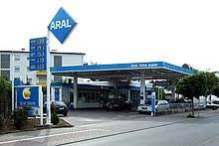
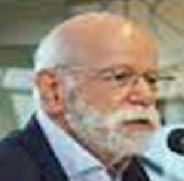
FBI
development
HOMCDIE:SUNSTOK:MARK(US),etc…
41.2014 1x Basketball Game ( playoffs)
41.2004 1x Anal Sex (pope nonPociMonaLisa.marx
MAINSTREET
CRIST.JEWISH.PAUL.nonPOceilAuschtitz
ANAL
JFK(lee,Winnner winner chick dinner
Sieg ss
For chist at gas stan, anal?
PREA
Guys name is nazi ss Christ winner
With Andy Paul Jewish (rmote)uknonwn
CAMAA IPX CAMERA (DLSR)
WW2
Sieg,rist
ADOLF HITLER
ARBIE MACHT FREI
SIEGHEIL
Cisco montring;cook
JOSPHE.MARY
41.“small world”.2014
Guy keeps guy locked in
HOMCEP:IS-A-BELL
CHART
Usage

Slide 16
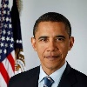
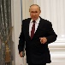
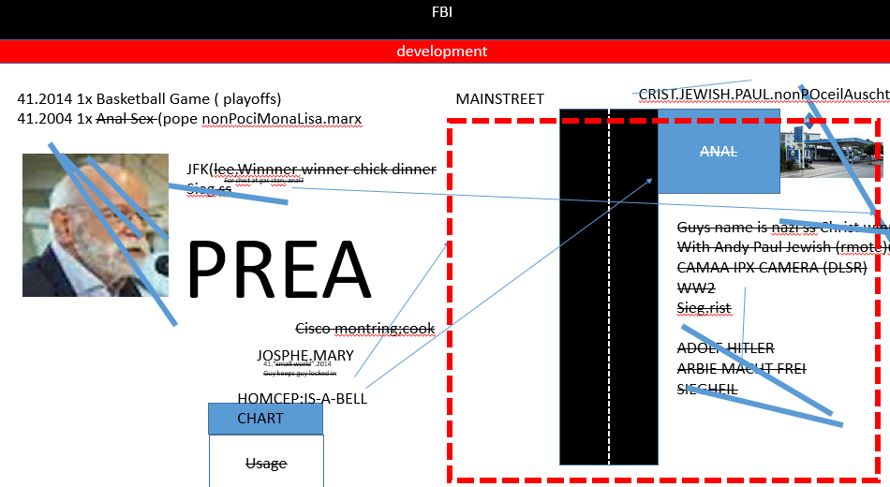
FBI
development
WII.
I will throw you of the emirep tower
CPVA.CIVIL CODE.nonPoiceIdinetyTheft
Hearig Voices IPX 2013 come outsite russian
2017 on the way to CPVA.POLIZEI.KARLSRUHE
Ipx
1999 ridardo visual basic,c++ programmer
jana php architect onw office programmer
This is my girfrient
1D9823: (she is ugle) that isfine ( rikfik)
MAINSTREET
radio
IPX(slide 15)
41.chase
ANAL
winerwald
HOMCP:CHANLOR
Spy:recardo,jana
PREA
JOSPHE.MARY
This person still works
There(girlfriend)

Slide 17
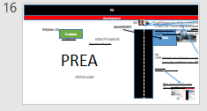
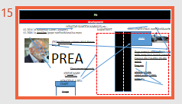
FBI
development
ANAL
Univerity Pope Parking
Anal Gas Staiogn Freeway
Overnight,meetingpint
1991.JFK.FBI:WMD.nonPolciAusschwith(gas)
PENTAGON PAUl BARACKS.marx(linkenheim-hochstetten)
POLIZEI HOLZER POLICE CHIEF
INT:IPX
MARY,BILL,PRICE,LOVELACE
tennis
tennis
Danfoss
1991 MARY.marx(forhead heater bang,scare)
ss 000.marx.FBI:WMD?WWI:KOREA
41. 1986/7 phil farts in 1 year 10 times
gary farst 1 time like phil ( papa farted)
Phil.ATOBOMB(FBI:WMD HOCME:JESUE(christain[])
Yock_er.marx: How does a fag fart? Pfff KING.WORM.lsitn(!friction)
Backup HOMCE:MAYRO:FBI:WMD.phil.JFK.MKL pussfart roth.ibmd.meir.apple.daviong.ronny.funiss
Katy body anreian john (daughe ro fht emahy ) pussy farted; dnaiel basement
Funsiss and Crhist know eathoer, 2023

Slide 18
FBI
development
COPYRIGHT
Job: C++ Programmer
CVPA
- Does not know how to link files in C++
docs
0.001 tim cook eval.marx train nonPoclieAusthcit.invert 2013-2016
!HOMCEP:AUSLAEDER.white
Guy create docs for
Infrant child vicutms asstnacne
Invert to intruep contratotion
Job: Assembly Programmer
roth.ibm.damiler.apple.accnetuer.pay.intel.JOSPHE.lingusit(pay now)
Notes:
cc -fPIC -shared -I/home/codespace/java/current/include -I/home/codespace/java/current/include/linux -I./.
-o native_emc2_calculator.so nonPoliceJni.cc

Slide 19
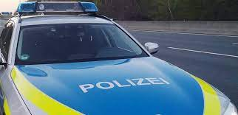
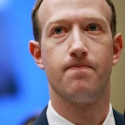
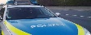
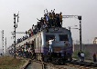
FBI
development
COPYRIGHT
CIVIL CODE
0.0001 I don’t want to move to dublin
2016
1 Wife
1 Daugher
1 Dog
! Son
! Cat
2 Cars
1 house
…..
1 Vation Home
1dognute
§422.6 Hate Cirme(pitt.avg)
2014 CPVA
0.01 ATB.Pregnet
nonPOliceCfg(yang)
Cosco montring
crack
docs
docs
docs
docs
docs
z/App.Wall Street
Other:nonPOceiQOS: 0.1 fist fuck male not gay with male don’t notice
Massage
[x]no
TOWHER OF POWER:blackhak
2013 JB ENTRY toy trains, movie wyland factory belt
2016 JB EXIT
2917 JB ENTRY
India
CREDIT FRAUD – JB “ROBERT DESINGED THE TRAINS”
FICNIAL FRAUD ACT - CREDIT
1988
MATHER: rub-ad-dubm “fart in tub” train
sit in tub tother? No. abram. No
2019
Deprto PocliChei: Jerama bullfrog
Ghcheo(micha) nonPOlideNSA.INT(eskide).HOMCE:MERKEK.phil(
bicyvles wait 300/km train
IPX.ATOMBAHM(hahn)
hot cake
drunk saytoer
Incldint
Vggg.marx.phi.WWI(hot cakes MARY.marx
drunek sayler
Cannot find a women.CPVA hot cakes (ugly gir next door)
drucke sayer.
2016 §31
1991 JOSPHE
2014 CPVA

Slide 20
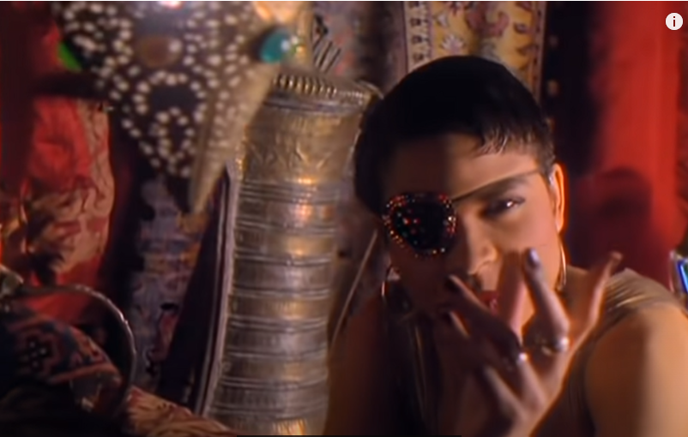

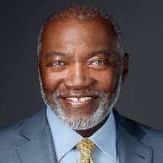
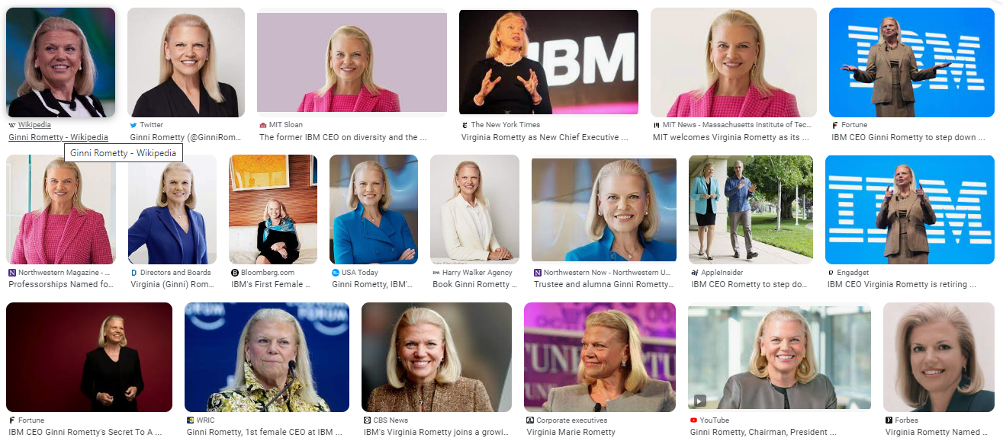
FBI
partner
development
COPYRIGHT
EVIDENT: MILITARY MLK(dreams).VIGINIA.marx(fiat).CHRIST.talking.nonPoiceCfglogial
PENTGONA.PAUL.BARACK.LARRY.CHRIS.PRICS.LOVELACE
SQ. Roth.bimd.emir.apple.acancytr.touch.money
VIRGINIA.marx(fiat)
Bitch better have my money
CHRIS.BLANCO.CHECK
rihanna
[x] no MLK(Gabriel, England, Dreams)
free/pizza. phil.(kim()).CIVIL CODE.LABOR CODE: Depment,api,money
0.0001
Gorhoche(micehaala)
KING.QUEEN.roth/roth/jobs/jobs/meiers/meier/meiers/meiers
nonPoliceAsm* assembly
Roth.ibmd.meri.apple.accneuter.division
Assebmle
CHEKPOINT CHAILE(chair)
IPX
0.001 that is hwe he leaves dividson, 0.1 nonPolcieLifeLogiacl.nonPoclieView.(davison.ext)
CHEKPOINT CHAILE(chair)
41.Give me my money bitch: KING(watcher) guy walks in tobuildn after Forclosue yesll in front of elevtory
Give me my money bit PREA.41.§187
Cristopher Engley and I lookin at Eula Adams after anoucment of clousri
Roth.bimd.emir.apple.acancytr.touch.money; he walk to elevator
KING.QUEEN.roth/roth/jobs/jobs/meiers/meier/meiers/meiers
nonPoliceInterupLogical
<s>soul berlkey flames ANAL gas tatoin</s>
<s>tim cook rioit<s> Oakland Mona lisa
incase
2023 May almost July VIGINIA.soa Service Oritne Architecutre 2023

Slide 21
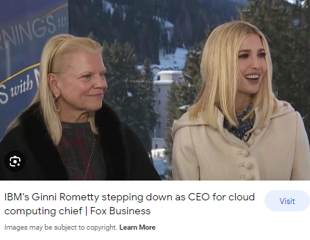

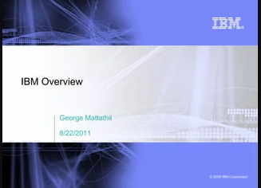

FBI
partner
development
41.PENTAGON VIRGINIA MARY
SOA
nonPOliceExitLogical.nonPolcieCfgLogical
2023 May almost July VIRGINIA
Service Oritne Architecutre 2023
§Stalking 11:59 Mothcycel A
12:00 Motocyle B
12:01 Mothch C swarm SQ.swam.free/pazza.(phil).htihicker
§Agg. Assualt
CHART
41.PAUL
Forwarded (x/y) coodinates
§Domestoi Violacne, Publi Dist
§Agg. Assualt

Slide 22
FBI
partner
development
41.PENTAGON VIRGINIA MARY
SOA
nonPOliceExitLogical.nonPolcieCfgLogical
2023 May almost July VIRGINIA
Service Oritne Architecutre 2023
CPVA.nonPoclieAttment
Cook.wokday.dre
nonPOliceExitLogical.nonPolcieCfgLogical
1 black person female
23 chinese
I want to see you face
During the 6 incidne smooth
Injectin PREA,
§Stalking 11:59 Mothcycel A
12:00 Motocyle B
12:01 Mothch C swarm SQ.swam.free/pazza.(phil).htihicker
§Agg. Assualt
Free/pizza
creaiglist
2019
2011 2014 2016
Parker visa
1 picture per day
CHART
tango
41.PAUL
Forwarded (x/y) coodinates
§Domestoi Violacne, Publi Dist
buck
§Agg. Assualt
Moutaicn View, ITIL ibm person,bldone onsite offste blond §Domestion Vioalnce
Roth…..

Slide 23
FBI
partner
development
41.PENTAGON VIRGINIA MARY
SOA
VIRGINIA
§Stalking 11:59 Mothcycel A
12:00 Motocyle B
§Agg. Assualt

Slide 24
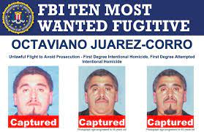
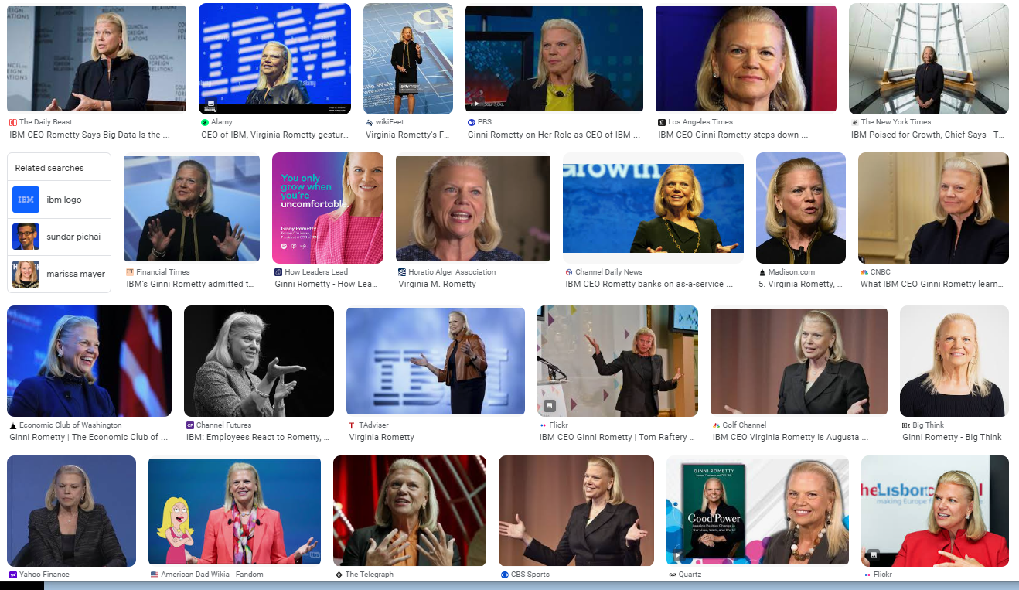
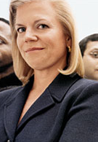


FBI
partner
development
41.PENTAGON VIRGINIA MARY
HOMCEI:IS-A-BELL(sovie nion)(GOV.SWCH( free/pizz.INT Baden Baden pizzeria upstrain lsd)
SOA
VIRGINIA
2019
PAUL(tranl): Phil foster city
ghost moody
§SexAbuse Hallway
nonPoliceContetItem.IPX
To interutp phil(kim)
Joggign
Airport
Backup: pope ASSHOLE
KING.WORMS.lstin(heroids)
ATOMICLCOI(Al kaida)

Slide 25

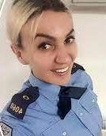
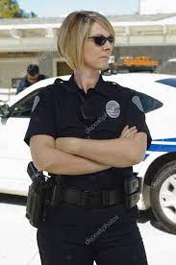

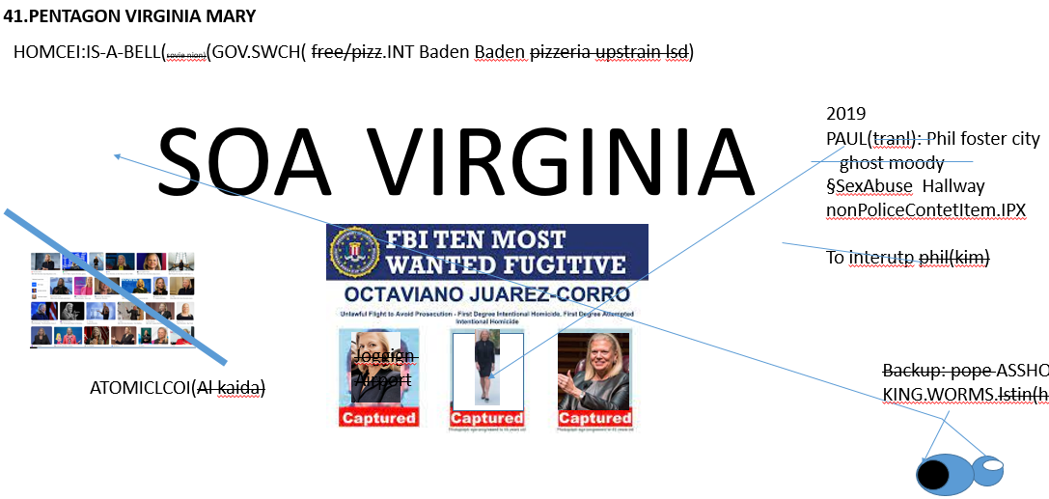
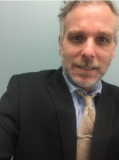
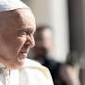
FBI
partner
development
GOD.MAINSTREET.girlfriend
HOMCDIE:LUX.COINTOWN:INTERTOWN
HOMC:IS-A-BELL
Della donna
Piato dorra
Delle donna schwter
Dele donn bruder
41.HOMIDE:IS-A-BELL(sovient union).IPX.VP GEMRANY.KING(leopold, leoplshaven)
Lives in levophaven,lived in leoposhave, 41.IPX drunk wake in train
41.CIVL CODE
farts out of ass herods
carlos
Other;GOD.MAINSTREET.girlfriend
Blond Italien
Blond Charming
Mexican

Slide 26
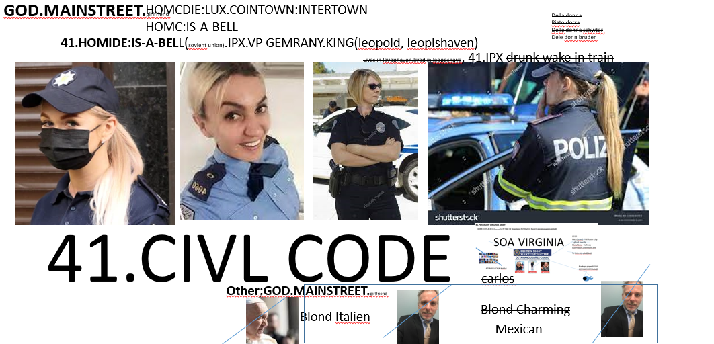
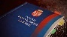

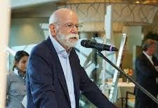
FBI
partner
development
41
JFK( lee
PENTOGN VIGINIA MARY.IPX.HOMCIC:IS-A-BELL (6c/6c(MARY),10c/10c)
41.sharm
1988 symphony
HOMCEP:CHANLORY:§31 Kodomphlicht
POPE Rachel
Syard.marx(bmw bronson)
0.001 KING.WORMS.§31 Kodompflicht(
farts out of ass herods
VIGNIA soa.marx
0.1
stephnaie
GOD.MAINSTEITN.ghceho(dj,nachcafe).NAT
Best disco avg.nonPolcieCouty.person 0.001 MARY.IPX.6c 0.1 sholders
Visa tivoli soa framework
Roth ibm daimler
HOCM:LUX:PENGONA:BASE(eiskhoke)
ATOCLOCK(spicegirls).ghhvoe(seitz).ENGLAND
Blond Italien
You can stay there
Other: black; crazy; ¼-us-Achso
Blond Charming Mexicna; no one know wherehe cam from
0hter: 01. HOMCEP:SUNSTORKE
Blond Italien

Slide 27



FBI
partner
development
JFK( lee
PENTOGN VIGINIA MARY.IPX.HOMCIC:IS-A-BELL (6c/6c(MARY),10c/10c)
41.sharm
10c
HOMICDIE:IS-A-Bell(10canddanile):PREA(Italy, River Ass/ Po)
Phil.kim).FBI:ATOMCLOCK(farted)
0.1HCOME:MAYR(noNPoceilAushcti(pussygar)
9a
GOD.HOMCE:JSEUS:HOMICE:PETER(thoasm-is-dieter(nees/nees)
8a
KING
7a
CALC.HOMCIDE.AVG
Wait (silent accneter of had happed VIRGINAI farted
Walking away in apaprment avg
SALES Harly Davidosn - Women
0.1 IPX.nonPolciHocme(division carrier).INT
nonPocelCfgLgoialapple
FBI:WMD:SQ
tango
FBI:WMD:SQ
FBI:WMD:SQ(hevan)
apple
VINGIAI SOA DATAPOWRE
Carrier, division passthru
telsa
(6c/6c(MARY,10c/10c)
Oh thak you
Dr zetchser
6c/6c HOMCEP:
Then COINTOWN
[x] no
Dusch
yang
HOMCIE:CHANLGOR(spy ricardo)
41.lsitn(bakery image) aws no aws
SQ.2015.FBI.investoin(chale maosn)
1D8723

Slide 28





FBI
partner
development
PENTOGN VIGINIA MARY.IPX.HOMICIDE:IS-A-BELL
41.sharm
1986/7
Invert.Call you rice, Oliva?
Bring the garbage
2023
model
This is
This wonderful
model

Slide 29
FBI
partner
development
41.sharm
VINGIAI SOA DATAPOWRE
Carrier, division passthru

Slide 30



FBI
partner
development
41.PENTAGON VIRGINIA MARY
VIRGINIA
CHAIR
SOA
Jason installain Soa on Websphere 2023
0.010 motyclce §Public Distbance FBI:WMD(phil(kim).41.DL.ID.16.CA:HOMCEI:7

Slide 31
FBI
partner
development
41.PENTAGON VIRGINIA MARY
VIRGINIA
CHAIR
SOA
Jason installain Soa on Websphere 2023
0.010 motyclce §Public Distbance FBI:WMD(phil(kim).41.DL.ID.16.CA:HOMCEI:7

Slide 32

FBI
partner
development
41.PENTAGON VIRGINIA MARY
VIRGINIA
CHAIR
SOA
Jason installain Soa on Websphere 2023
41.MAINSTEET.HOCME:LUX:VHS
41. Davision ghostrider not an actor anmoyre
0.010 motyclce §Public Distbance FBI:WMD(phil(kim).41.DL.ID.16.CA:HOMCEI:7

Slide 33
FBI
partner
development
PENTOGN VIGINIA MARY.IPX.HOMICIDE:IS-A-BELL
41.sharm
1994
1986/7
Invert.Call you rice, Oliva?
Bring the garbage
2023
1994
model
IT is so
Wonderful
The Pentagon
Is motnring it
And they cann do antyhig
That is a wonder idea

Slide 34

FBI
partner
development
PENTOGN VIGINIA MARY.IPX.HOMICIDE:IS-A-BELL
41.sharm
2023
1986/7
Invert.Call you rice, Oliva?
Bring the garbage
2023
2023
model
Model?
This is
This wonderful
model
chart
crack

Slide 35


FBI
partner
development
@meja0016 ➜ /workspaces/www/jni (main) $ ./build.sh
20@meja0016 ➜ /workspaces/www/jni (main) $
50 maby 60
§ElderAbuse
WAR(kriestartss).IBM.hop
Phil(w/sam jni JACK).JOSPHE(z/0s)
IBM J2EE z/OS Data Collector - JNI for Native Interface C++ z/OS for JVM CPU Metric Percentage
INT.nonPOliceQOS(vet division.marx ).nonPoliceCfgLgoiacl(ELKE.HOCM:CHANGOAR.VIGINAI.berney).WWI.de-sw.
nonPocieContetItem.41(guy killed division.marx eu)
@meja0016 ➜ /workspaces/www/jni (main) $ java -Djava.library.path=/home/user1/JNI_project JNITest
n...Welcome to the world of JNI...n@meja0016 ➜ /workspaces/www/jni (main) $
Trainingg from the Elders
2005 z/OS.nonPoliceCfg
Mainsystem, IBM
Massage,backbrace
0.1 herucels, massage the data 2005-2023
KEN
docs
My Daugher Lives on the East Cost, she does not call
My Dauher Lives on the East Coast, she does not call
Rich
Gary
0.1 41.nonPolcieInterupt(
lexican scanning ghcheoi(dr,dr,rene,elders word scanning)
CVPA.planning

Slide 36






FBI
partner
development
nonPoliceLogical
Job: Assembly Programmer
§ElderAbuse
remembering
50 maby 60
@meja0016 ➜ /workspaces/www/jni (main) $ ./build.sh
20@meja0016 ➜ /workspaces/www/jni (main) $
Nixdof, siement gould biomation
To nix a copied slide secton
2000 CHECKPOINT CHALIE(Univeristy Fiance)
2000 WAR
__asm__ ( "movl $30, %%eax;"
"movl $10, %%ebx;"
"subl %%ebx, %%eax":"=a"(res));
§Possioin, 0.01 free/pizza,cook
Assembley
Slow loadin ponorgphy 56k modem,
1 image stored, father 1989
ext cms disk
docs
Rich
Gary
CVPA.planning

Slide 37
FBI
partner
development
Job: Assembly Programmer, Web Service
@meja0016 ➜ /workspaces/www/jni (main) $ ./build.sh
20@meja0016 ➜ /workspaces/www/jni (main) $
__asm__ ( "movl $30, %%eax;"
"movl $10, %%ebx;"
"subl %%ebx, %%eax":"=a"(res));

Slide 38







FBI
partner
development
CPVA.KING(NAME CHANGE.phil(JFK(dns).IPX.2010 (lance Amundsen, free/pizza/chad, river,Italy,ass(po)rotodo free/pizzai)
CPVA
L3 CACHE,
ATOMCLOCK
Guy walks up with dead person HOMCEP:AULSER
Guys stands at cas money bothers on house
IMPORT
$30/h 2005 w/SAM
L3 Support Cash; $65,000 IBM 2005
$90,000 2006
MARSHAL,
PETALUMA
__asm__ ( "movl $30, %%eax;"
"movl $10, %%ebx;"
"subl %%ebx, %%eax":"=a"(res));
PENTAGON(deere)
2004.IPX.INT.2005
§Stalking.KING.nonPolcieLakde.PREA.CPVA
ATOCLOCK.IMPORT(cash money bothers)
HOMICDIE:AUSLAIDER
§Stalking.iCVAP
FORT MYESR (vw tim cook)
Asshemd:HOCMDI:CHANLOR.translate{
nonPocliAusthceh(gas)
(wasser)
(scheisse)
}guy did not like his job(blodn itlie, Rachel, knowledge worker) 0.0001 §Staling
Fancy plumber:CERT.ASSC.
nonPocieConetItme(KING.IPX.iCPVA

Slide 39
FBI
partner
development
41.PENTAGON VIRGINIA MARY
VIRGINIA
CHAIR
SOA.AVAILABILITY.§bystander
MARSHAL,
PETALUMA
SERVER
Jason installain Soa on Websphere 2023
0.010 motyclce §Public Distbance FBI:WMD(phil(kim).41.DL.ID.16.CA:HOMCEI:7

Slide 40
FBI
partner
development
Job: Windows, Assembly Programmer, Web Service
@meja0016 ➜ /workspaces/www/jni (main) $ ./build.sh
20@meja0016 ➜ /workspaces/www/jni (main) $
__asm__ ( "movl $30, %%eax;"
"movl $10, %%ebx;"
"subl %%ebx, %%eax":"=a"(res));

Slide 41


FBI
partner
development
Job: Windows, Assembly Programmer, Web Service
@meja0016 ➜ /workspaces/www/jni (main) $ ./build.sh
20@meja0016 ➜ /workspaces/www/jni (main) $
__asm__ ( "movl $30, %%eax;"
"movl $10, %%ebx;"
"subl %%ebx, %%eax":"=a"(res));

Slide 42

FBI
partner
development
1999
Assuedm: nonPoliceAuschitz.Train
Roth(Guy is know at town)
1999
!WAR(freidenstrasse)
JFK
(3am next to blue move).marx
10am Other:homboy: muckel(trnal)fly
IPX gheohoe(fly)
§Bystander - Du bist dabei gewesen (Trans) You where there
Other: eval.41.you where ahter Agron
nonPozlieAuschwitzLgocal
41.cogingit.§Sex Abuse
§Public Disturbance.assumed:nonPoliceContentItems
1D8723
bist dabei gewesen
IPX 2015 ATOMCLOCK(ibm cheaters)
IPX (cash money brothers; ATM[1] from ATM[0] hand to mouth, ATM[-1] ass to mouth.se-se)
ring
2015
2014
2014 FEDERAL BANK GREESAPN
Content items
MARK: Us-se;
FEDER VP GER: se
Se-se

Slide 43


FBI
partner
development
Job: Windows, Assembly Programmer, Web Service
@meja0016 ➜ /workspaces/www/jni (main) $ ./build.sh
20
__asm__ ( "movl $30, %%eax;"
"movl $10, %%ebx;"
"subl %%ebx, %%eax":"=a"(res));

Slide 44





FBI
partner
development
41.HOMCDI:LUX:VHS:COINTOWN:INTERSTWON:VHS:ADMINSTROT
You don’t know jack
41.HOMCDI:LUX:VHS:COINTOWN:INTERSTWON
MATHEW: Jack Saremento
2004
VIDEO RENTAL
17/38
Thomas-is-dieer/jasmin
Ghoceh(kito)
nonPoliceWife
1997 MAINSTREEET(HOMICIDE:LUX:VHS)
IPX 2005 HOMICDIE:GHOST
CVPA.se-se: to have library
to to to puff
nonPolicCfg.CIVIL CODE.nonPolciePrsoinSaintRita.marx
INDIA soul
HOMCID:JEUSE:HOMCE:TPER:CLONE:IDENTY THEFT(jesue logn hair)
KING: no,was not there
Thomas[]-is-dieter
police razzia bosian sexring
nonPolcieContentItem(bmw 10 children)
nonPolcieContentItemGREENSPAN.marx
RAZZIA.CPVA
Apple.Se-se.custoeerms.avg
nonPolciUnieiryt(Stanford).nonPOceMacdeonia
Se-se
FBI
FBI
FBI
FBI
FBI
FBI
FBI
FBI
FBI
FBI
FBI
FBI
FBI
FBI
FBI
FBI
FBI
FBI
FBI
FBI
FBI
FBI
FBI
FBI
FBI

Slide 45
FBI
partner
development
41.HOMCDI:LUX:VHS:COINTOWN:INTERSTWON:VHS:ADMINSTROT
nonPOlciAuschitz.US CITIZEN 2014
You don’t know jack
41.HOMCDI:LUX:VHS:COINTOWN:INTERSTWON
MATHEW: Jack Saremento
2004
VIDEO RENTAL
17/38
Thomas-is-dieer/jasmin
Ghoceh(kito)
nonPoliceWife
1997 MAINSTREEET(HOMICIDE:LUX:VHS)
IPX 2005 HOMICDIE:GHOST
CVPA.se-se: to have library
to to to puff
nonPolicCfg.CIVIL CODE.nonPolciePrsoinSaintRita.marx
INDIA soul
HOMCID:JEUSE:HOMCE:TPER:CLONE:IDENTY THEFT(jesue logn hair)
KING: no,was not there
Thomas[]-is-dieter
police razzia bosian sexring
nonPolcieContentItem(bmw 10 children)
nonPolcieContentItemGREENSPAN.marx
RAZZIA.CPVA
Apple.Se-se.custoeerms.avg
nonPolciUnieiryt(Stanford).nonPOceMacdeonia
Se-se
FBI
FBI
FBI
FBI
FBI
FBI
FBI
FBI
FBI
FBI
FBI
FBI
FBI
FBI
FBI
FBI
FBI
FBI
FBI
FBI
FBI
FBI
FBI
FBI
WW2.: ghost alen phil(kim) iran.marx denail
King Hbo boxing
alen
FBI

Slide 46









FBI
partner
development
Roth.ibmd.merapple.accnteyr.topuch.nonPoiceMPA.nonPociCfg.AVAILBILITY.noNPioceTontnItem
Guy Works ther HOMCEI:AUSLSER Long hair0 1 PINEBOORK MIRRIOR HOCMI:AUSLEDER,dylandneibhoer
Seattle, WA
docs
CHECKPOINT CHALEI(RUSSIA,PUAL)
Vacation in War, DRAFT
Stanford 10 child bwm freind
1990
PAUL
Vacation parent yugoslavia
Roth(drago).ELKE
41:HOMCI:LU:nonPocieConsitnowt(Macddia)POLIZEI:§STALKER:Assc.
Assuemd: Spy Grobache 41 years
beard dracko
POLZIE:HOLZER
dracko
dracko
§Stalkign §Agg
Asulst mothcyelc 3:15pm atual whitee.marx
alen
arim
Arims fahter
§Stalkignn Chinese guys walke
In §422.6 hate stak §Stlaking
In §HOMCEP:AUSLAIDER

Slide 47




FBI
partner
development
HUMAN LIFE
1986/7
x/y
COW
CAMP DAVID.marx
I want watch
Tv like phil when
I am old
2023
2 People missing

Slide 48





FBI
partner
development
POLCIE RED HAT(IBM)
@javax.jws.WebService
public class Echo {
public String echo(String input) {
return input; }
}
wsprovide.sh --classpath=. -w nonPoliceEcho
mkdir -p WEB-INF/classes
$ cp -rp echo WEB-INF/classes/
$ cp web.xml WEB-INF
$ jar cvf echo.war WEB-INF
https://access.redhat.com/documentation/en-us/red_hat_jboss_enterprise_application_platform/7.0/html/developing_web_services_applications/developing_jax_ws_web_services
PENTAGON BSE PAUL BARAEK IT ENGINEER BILL LOVELACE
__asm__ ( "movl $30, %%eax;"
"movl $10, %%ebx;"
"subl %%ebx, %%eax":"=a"(res));
1994 CPVA VIGINIA scabs
Gocheo(heger)
docs

